Slide 1
SHOBOT WEEKLY REPORT
J JAYAGOWTHAM
ME21B078

Slide 2
WORK PLAN FOR NEXT PHASE OF WORK
Researched and came up with an optimal work plan for the next phase (see Fig. 1)
Dataset preparation currently in progress
Annotating collected images using Roboflow, a website for machine learning applications (see Fig.2, Fig.3)
Planning to use the latest YOLO model to train on our dataset

Slide 3
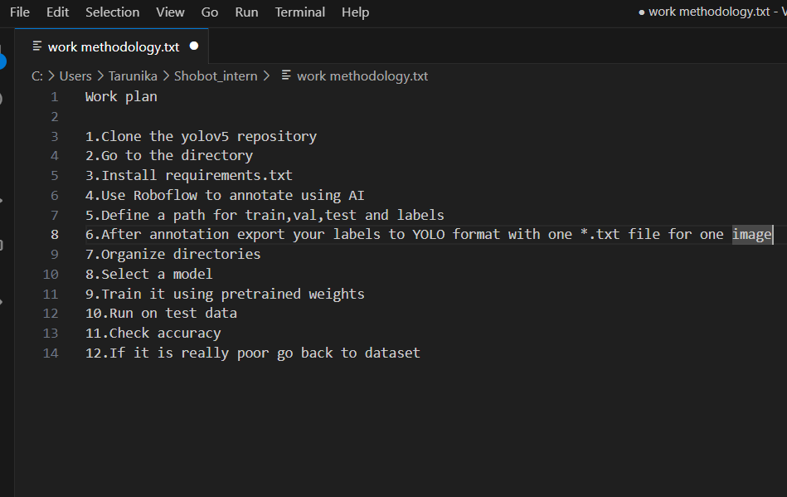
Fig.1 Work Plan

Slide 4
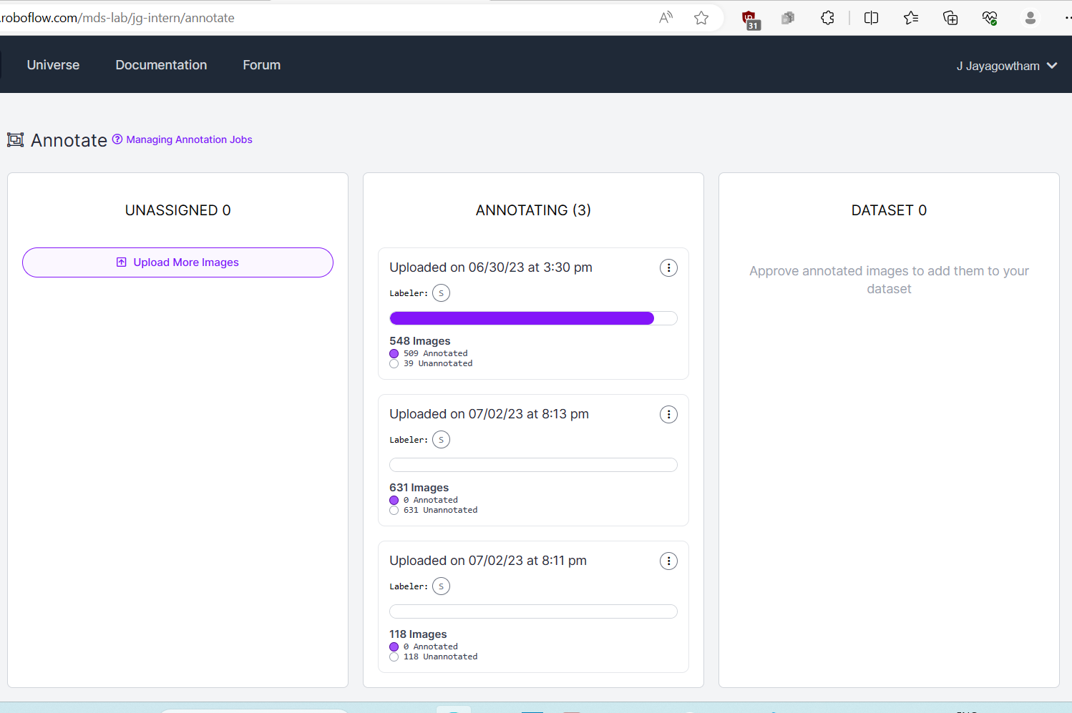
Fig.2 Roboflow website

Slide 5
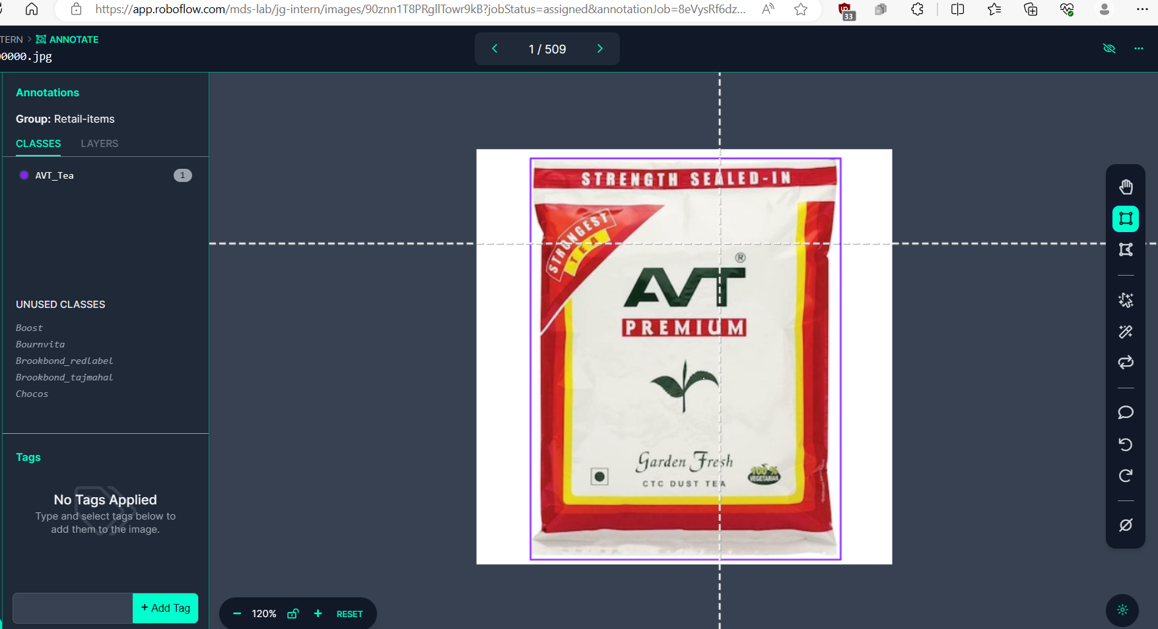
Fig.3 Sample annotation

